Slide 1

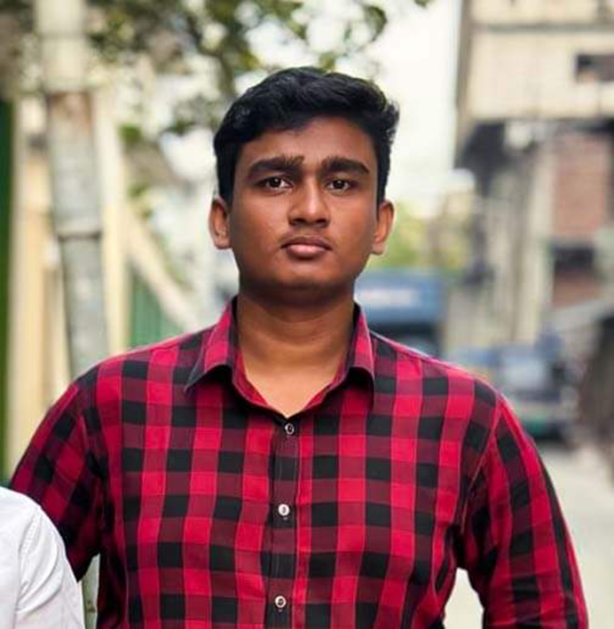
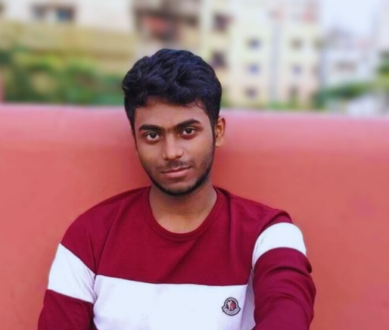
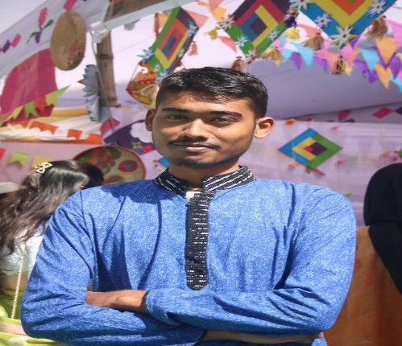



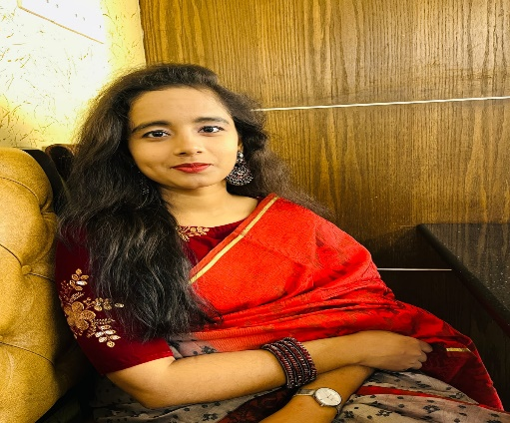
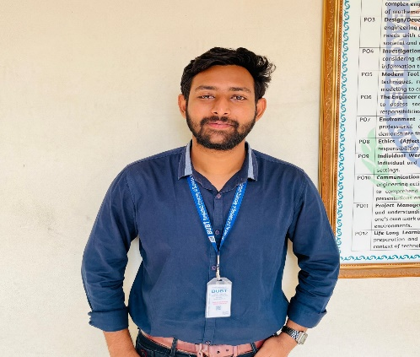
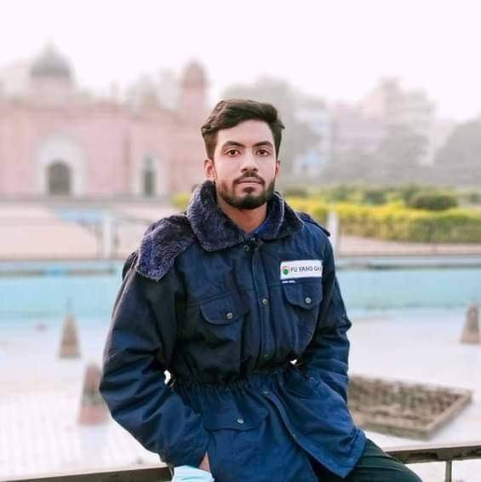


BUBT_Panda Coders
Muhammad Raihan Molla
Ehasanul Haque
Joy Gosh
Shamima Akter
Abdul Wahid
MD: Riad

Slide 2


Problem Fish
Registration
Management
Payment

Slide 3

Problem Statement
Management
Registration
Payment
We don’t have proper University management system
We have weak and slow online Registration system
WE Don’t have any proper Payment Gateway for student
1
Weak management
1
New Semester
1
Online payment
2
Not available 24/7
2
New Admission
2
Payment Confirmation

Slide 4

University Management System
Where We Will Try solve
every problem

Slide 5


Management Administration
Human Resources
Administration
Database
Others

Slide 6





Software Overview Visualizations
Faculty Member
Student
Teacher Assistant
Employees
Graduated
Admission Panel
User
1
2
3
4
5
Faculty Member Record
Student Record
Teacher Assistant
Graduated
Admission Panel Record
University Administration
1
2
3
4
5
Welcome
Logout
MainMenu

